Slide 1

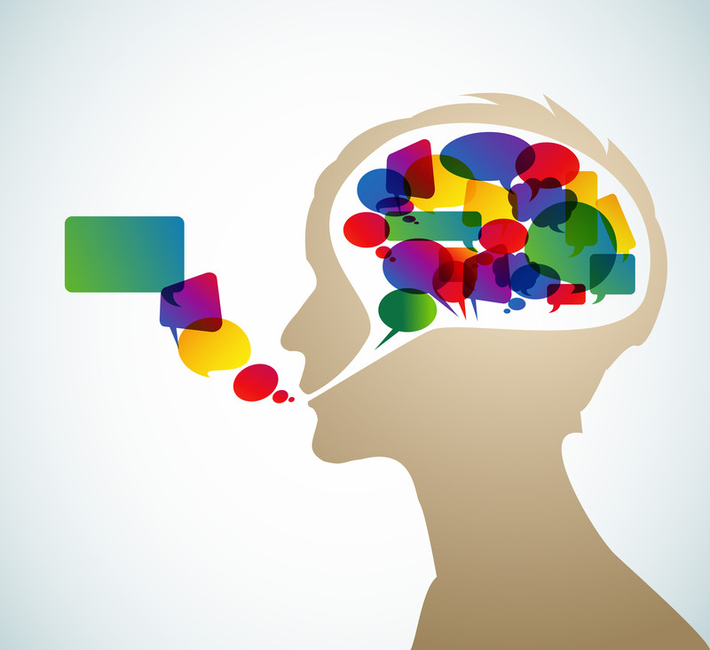

Seminar Automatic Question Answering Using IBM Watson SS2015
s..Stutter
An IBM Watson Approach to deal with Stuttering

Slide 2
Contents
Introduction to Stuttering
Current measures
Our Idea
Flow chart
Demo
Future plans
References

Slide 3
Introduction to Stuttering and Disfluencies
STUTTERING : characterized by disruptions in the production of speech sounds, also called "disfluencies“
Two fundamental measures
frequency of disfluency
types of disfluency
Basic procedure involves observing a speech sample and counting fluent and disfluent words (either video tape, audio tape or in person).

Slide 4
TYPES OF DISFLUENCIES
Hesitations: silent pause of 1 second or longer (ie: I.. (pause)..want the red one)
Interjections: meaningless words irrelevant to the message [um/like/well/uh] (ie: I um want the red one)
Revisions: change in content, grammar, or pronunciation of a message (ie: I want the blue…the red one)
Unfinished words: a word that is abandoned and not completed later in the message (ie: I want the oran....red one)
Phrase repetitions: repetition of at least 2 complete words of the message (ie: I want…I want the red one)
Word repetitions (up to 2x): repetition of a whole word in a slow casual way (ie: I I want the red one)

Slide 5

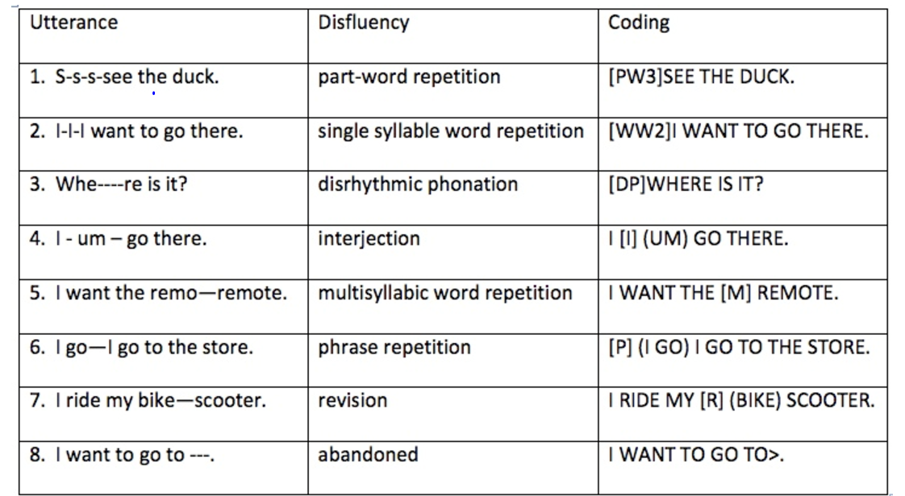
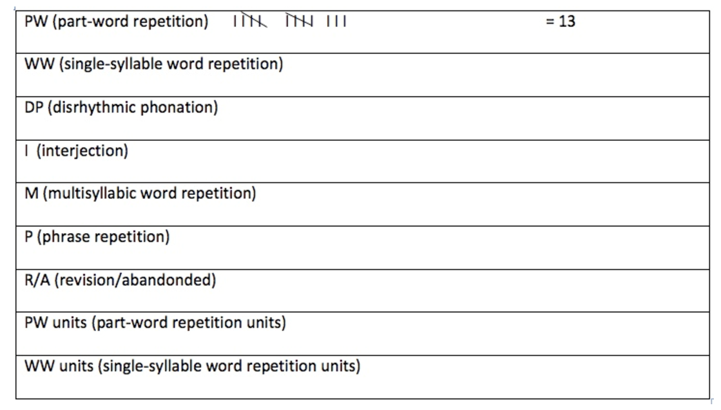
Current methods to measure stutter
Notes:
Note that in the coding, for repetitions (utterances 1 and 2 above), counts of repeated units are made to calculate the mean number of times the child repeats. If there is more than one disfluency on a word (a disfluency cluster), each disfluency should be coded. So, for example, if a child says "d-d-d-----dog dog is big," the part-word repetition, prolongation, and single-syllable word repetition would all be coded ([PW3] [DP] [WW1] DOG IS BIG).
If a transcript is not made, clinicians can listen to the speech on a good quality audio recording, play and replay the audio as often as needed, and tally the disfluencies as they are heard. A sample tally sheet follows, with the first line of disfluencies tallied as an example:
The units at the bottom of the example are used to tally the units of repetition. For example, if a child said "S-s-s-see the duck," the clinician would make 1 tally mark under "PW" to indicate 1 instance of part-word repetition and 3 marks under "PW units" to indicate 3 units of repetition.

Slide 6

To create a tool to be used by speech language pathologists for analyzing stutter patterns in the speech (AUTOMATIC ASSESSMENT)
As a self-help tool to be used by patients themselves in order to understand their speech and disfluencies
Record your practice sessions and get detailed results at your own convenience
Accurate time stamp markings of hesitations
Documenting all the repetitions to get an idea of the syllables uttered incorrectly most of the time

Slide 7

IBM Watson’s Speech-to-text API
It uses speech recognition capabilities to convert following languages from speech into text
Arabic
English
Spanish
French
Brazilian
Portuguese
Japanese
Mandarin
Upload pre-recorded audio (.wav, .flac, or .opus only)
To transcribe the human voice accurately, the service uses machine intelligence to combine information about grammar and language structure with knowledge of the composition of the audio signal.

Slide 8
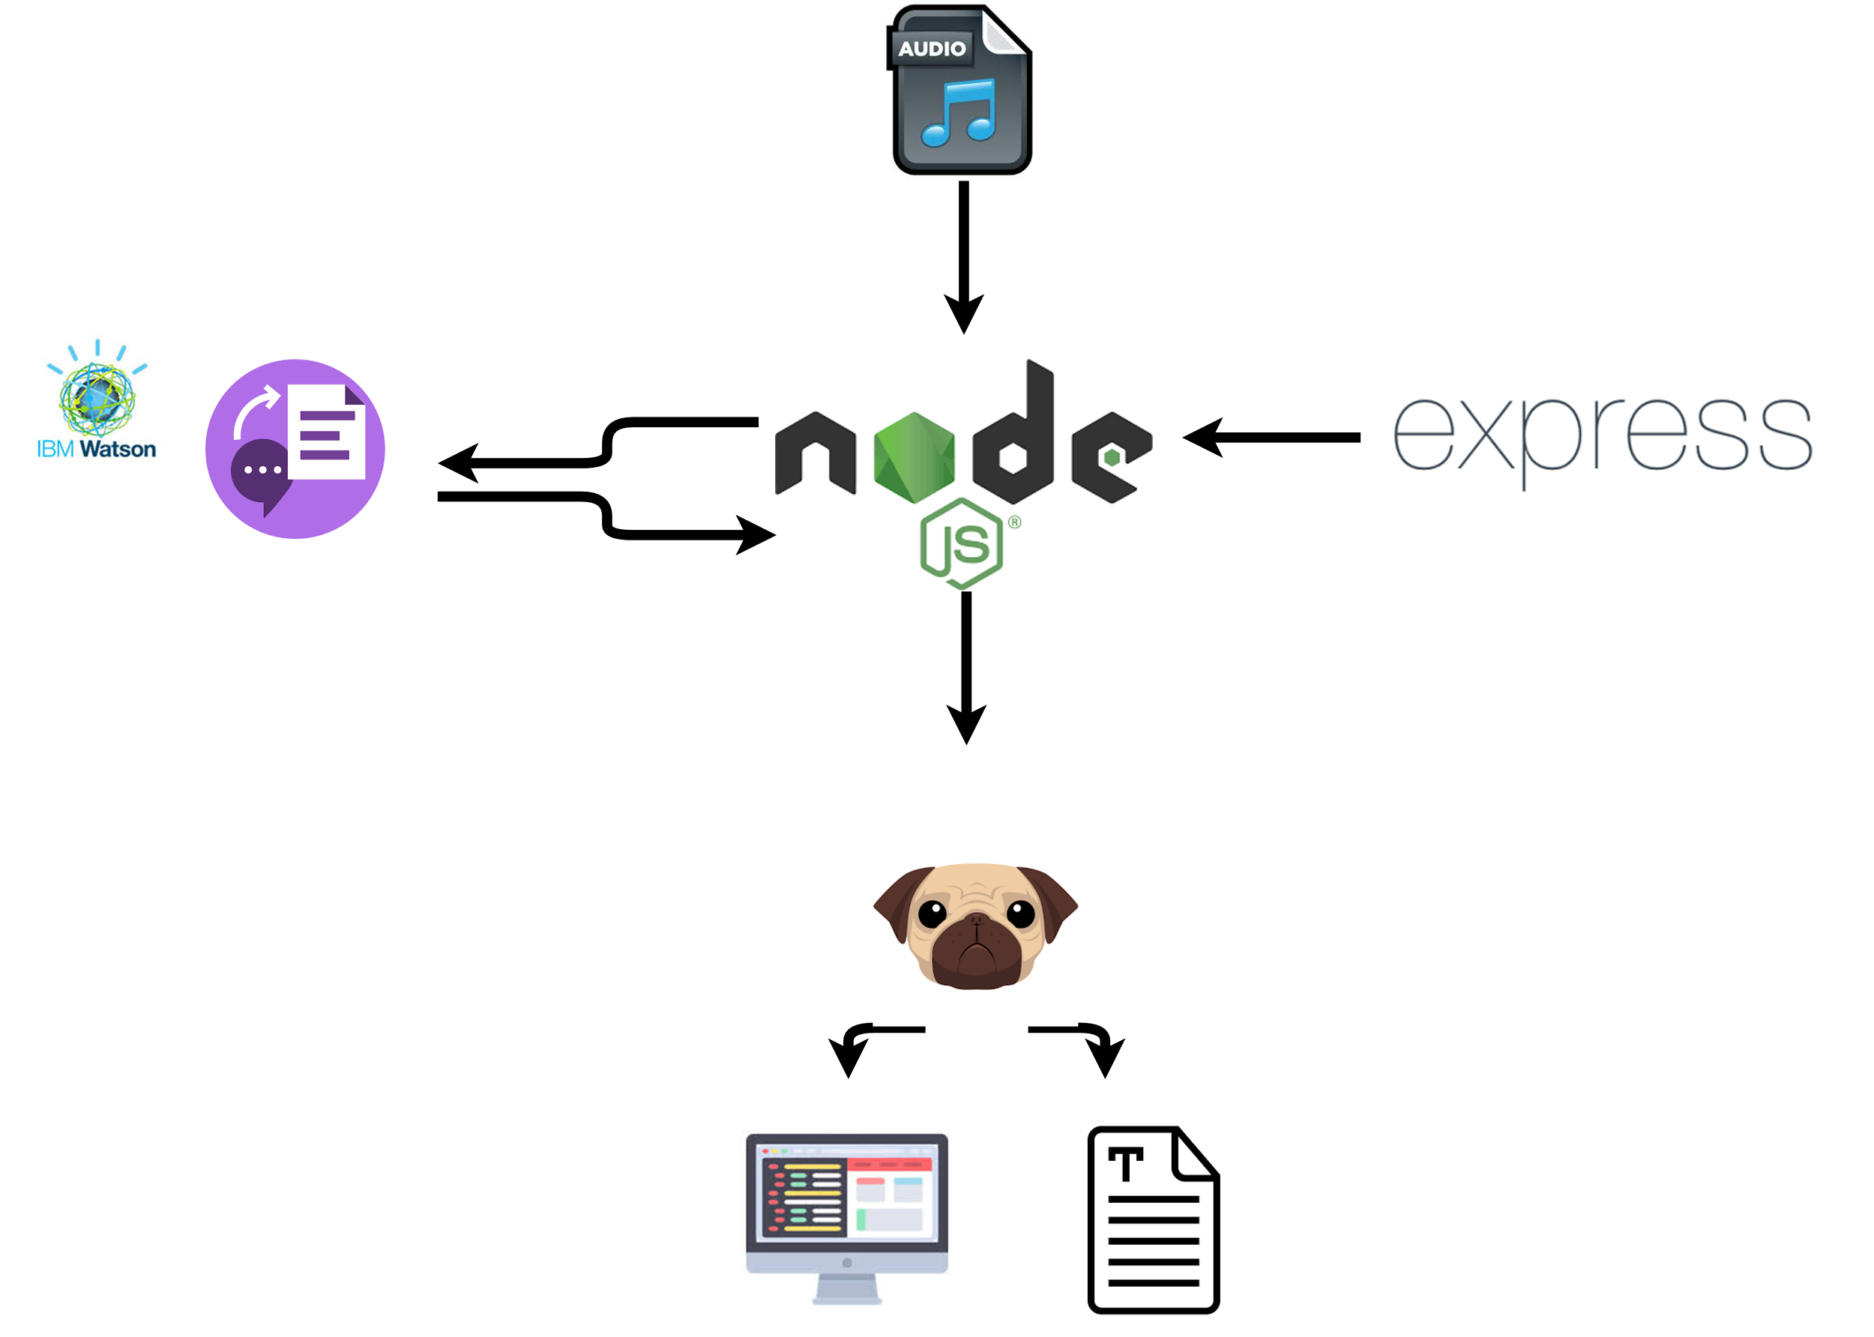
Flow
Speech-to-text API
Web development framework
Pug – Templating Engine

Slide 9
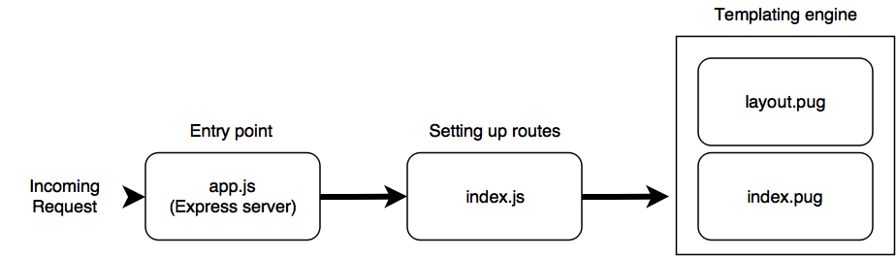
Code Structure

Slide 10

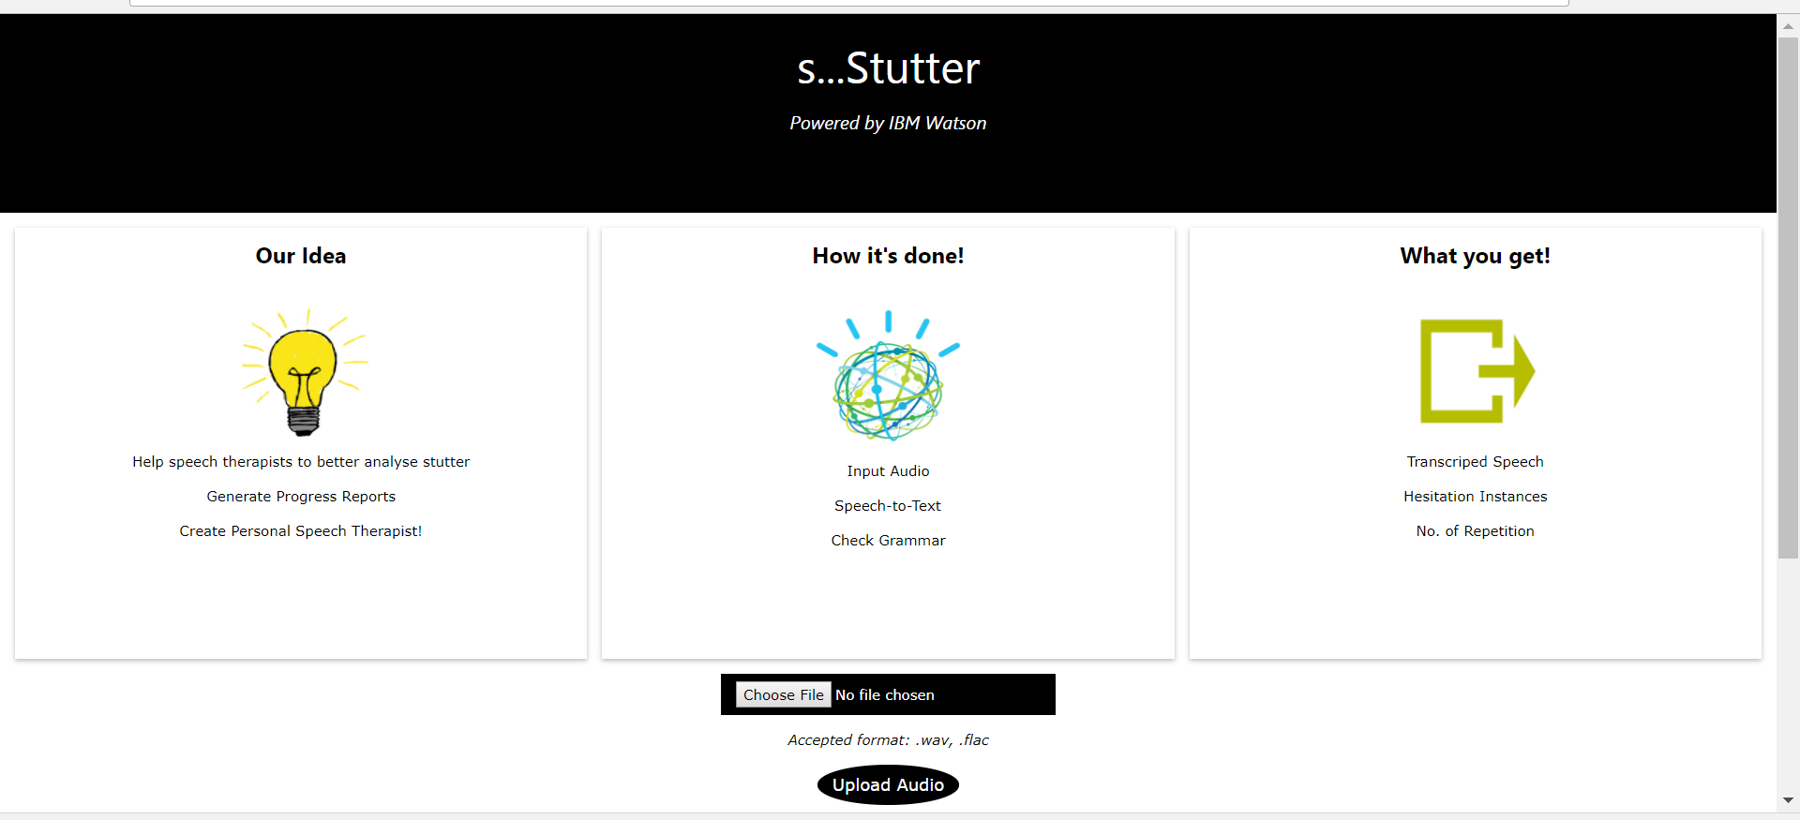
https://s-stutter.mybluemix.net/
Deployed to Bluemix

Slide 11
Dataset
University College London’s Archive of Stuttered Speech (UCLASS)
Recordings of speakers who stutter and background details about these speakers and the conditions in which the recordings were made
DIVISION OF PSYCHOLOGY AND LANGUAGE SCIENCES - SPEECH TEAM
Peter Howell, Stephen Davis, Jon Bartrip and Laura Wormald
Special thanks - Dr. Tino Haderlein (Researcher, Speech processing Group, FAU)

Slide 12
Future scope
Creating a chatbot -> “Personal Speech pathologist”
Converses with the patient encouraging repetition of words detected through previous step
Or facebook Messenger chatbot
Detect improvement in user’s speech through repeated use and displaying graphs
Extend for real-time analysis – Websocket interface
Client requests/audio service
receives
results
single connection
{asynchronous fashion}
Audio streams directly from browsers (HTML5 WebSocket clients) to the service
Reduces latency

Slide 13

References
http://www.uclass.psychol.ucl.ac.uk/
https://www.ibm.com/developerworks/cloud/library/cl-bluemix-fundamentals-create-and-deploy-a-node-app-to-the-cloud/index.html#step2
https://github.com/watson-developer-cloud/node-sdk
https://docs.api.ai/docs/facebook-integration
http://www.asha.org/uploadedFiles/asha/publications/cicsd/1997ClinicalMeasurementofStutteringBehaviors.pdf
http://www.fluencyfriday.org/realtimeanalysis.pdf
http://www.mnsu.edu/comdis/isad13/papers/sawyer13.html

Slide 14

Jalil Ahmed ( 22062335 )
Prachi Govalkar ( 22062833 )

